Slide 1

Fundamental of ODS Graphics Kevin Kane October 2017

Slide 2
Agenda
Introduction to SAS ODS Graphics
Comparison with traditional SAS/ GRAPH
Statistical graphs using SAS analytical procedures
Break – 10 minutes
Statistical Graphics (SG) – SGPLOT
Lunch Break
Exercise - SGPLOT
Statistical Graphics (SG) – SGPANEL
Exercise - SGPANEL
Break – 10 minutes

Slide 3
Agenda
Graphics and the Output Delivery System (ODS)
Exercise – ODS
Conclusion and Further Readings

Slide 4
Introduction to SAS ODS Graphics
Statistical Graphics (SG) procedure was first introduced in SAS 9.2
Part of SAS/GRAPH
SG was rebranded as ODS Graphics in SAS 9.3 and became part of Base SAS®. SAS/GRAPH is now called traditional SAS Graphics (hereafter TG)
Significant enhancements made in SAS 9.4 release
SG is relatively easier to use and produces high quality graphs with less effort. But it is not yet supersede TG
SAS® is still supporting TG but more emphasis are on SG in future.

Slide 5
Introduction to SAS ODS Graphics (cont.)
Automatic graphs from procedures.
No knowledge of graph syntax required
No need to “twist” the data as the same procedure is producing analyses and graphs
Internal messages within the procedure are not lost
Graphics Template Language (GTL new in SAS 9.2)
Comprehensive syntax to define the structure of a graph
Complex / high level of features
Use in combination with PROC TEMPLATE
New SG procedures
Easy to use procedure syntax to access GTL functionality
SGPLOT: single cell graphics
SGPANEL: create multiple classification panels
SGSCATTER: comparative scatter plots and matrices

Slide 6
Introduction to SAS ODS Graphics (cont.)
ODS Graphics Designer
Point and Click interface
Create graphs using zero programming
Sometimes very useful to create complex graphics
Generates GTL code: useful learning tool
ODS Graphics Editor
Interactive graphical application used to edit and annotate ODS Graphics
Clever way to work around GTL
Allows annotation on the graph
Only ODS Graphics Editor (SGE) files and Portable Network Graphics (PNG) files are editable

Slide 7
Comparison with Traditional SAS/GRAPH
Traditional SAS/GRAPH
ODS Graphics
Device based (GIF, PNG, EMF etc)
Produces GRSEG entries in SAS graphic catalogs that can be rendered in standard formats (PNG, JPEG)
Graphs are viewed in graph window
GOPTIONS to control appearance of graph
Graphs are not produced automatically
Graphs are template based
Produces graphs in standard formats such as JPEG and PNG
Graphs are viewed in standard viewers (HTML, PDF, RTF)
Can use ODS GRAPHICS statement to control appearance of graph
Statistical procedures produce graph automatically

Slide 8
Comparison with Traditional SAS/GRAPH
Traditional SAS/GRAPH
ODS Graphics
Global statements AXIS, LEGEND, SYMBOL, PATTERN, NOTE, GOPTIONS are valid
Does not support transparency, gloss
Does not support scaling and anti aliasing
TG supports annotate facility, although it is programmatically intensive
These statements are of no use
Support transparency and gloss (9.3)
Supports both
Since SAS 9.3, SG supports annotate facility with some restrictions. This annotation facility is different from SAS/GRAPH annotation

Slide 9
Statistical graph using SAS analytical procedures
Many SAS procedures support ODS Graphics
Use PLOTS = option
Very handy to create quick graphs from SAS procedures
Statistical procedures include FREQ, GENMOD, GLM, LIFETEST
For full list SAS procedures supporting ODS Graphics

Slide 10
Example using PROC FREQ
ods graphics on;
proc freq data=qtcdata;
tables drug*qtc / chisq plots=freqplot;
weight risk;
run;
ods graphics off;

Slide 11
Example using PROC FREQ

Slide 12
PROC SGPLOT Basics
PROC SGPLOT creates single cell graphics. Plot statements can be overlayed. A typical single cell graphic has the following characteristics:
Titles at the top
Footnotes at the bottom
One region in the middle displays the data
One or more plots (histogram or line plot) are used to display the data
Legends or insets inside or outside the data display area

Slide 13
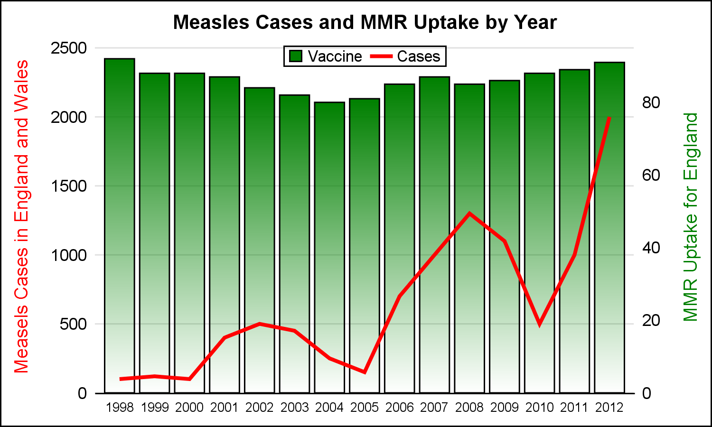
PROC SGPLOT Example: Single Cell Graphics

Slide 14
SGPLOT Syntax
proc sgplot data=<dataset> <options>;
plot statement(s) required parameters </options>;
<styleattrs statements>;
<refline statements>;
<axis statements>;
<inset statements>;
<keylegend statements>;
run;

Slide 15
SGPLOT Syntax
proc sgplot data=<dataset> <options>;
plot statement(s) required parameters </options>;
<styleattrs statements>;
<refline statements>;
<axis statements>;
<inset statements>;
<keylegend statements>;
run;
You can use one or more plot statements to display the data. Each plot statement has it’s own set of options. Many different types of plots are supported: scatter, line plots, regression plots showing confidence intervals, histograms, box plots, bar charts and dot plots.

Slide 16
SGPLOT Syntax
proc sgplot data=<dataset> <options>;
plot statement(s) required parameters </options>;
<styleattrs statements>;
<refline statements>;
<axis statements>;
<inset statements>;
<keylegend statements>;
run;
Supporting statements can be used to customise the graphs:
styleattrs, symbolchar, symbolimage
reference and drop lines
axes
insets
legends

Slide 17
Plot Statements
There are over 30 different plot statements that can be used. Each has required and optional roles, for example:
Scatter x=<var> y=<var>;
Scatter x=<var> y=<var> / group=<var>;
Scatter x=<var> y=<var> / markerattrs=(symbol=plus);
Series x=<var> y=<var>;
Histogram <var>;
Vbox <var>;
Vbar <var> / response=<var> colorresponse=<var>;
Vbar <var> / response=<var> group=<var> groupdisplay=<cluster>;

Slide 18
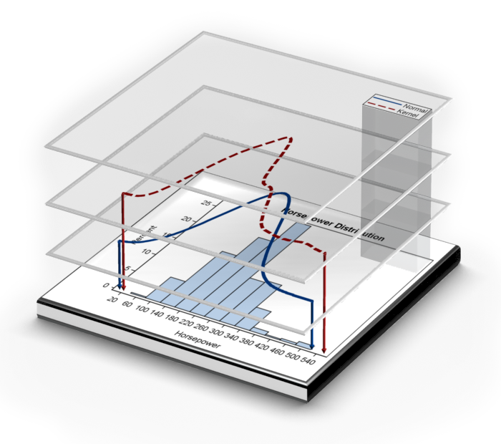
Plot Layering
A key feature of PROC SGPLOT is the ability to layer compatible plots to create more complex graphs. See documentation for details of what plots are compatible.

Slide 19
Exercise 1
Using the dataset SASHELP.HEART, created a 3 layer SGPLOT with the following layers:
A histogram of cholesterol
A density plot of cholesterol using default options
A density plot of cholesterol using type=kernel option
Format the graph in this way:
Create a legend in the top right area inside the data display area
Remove the label from the x-axis

Slide 20
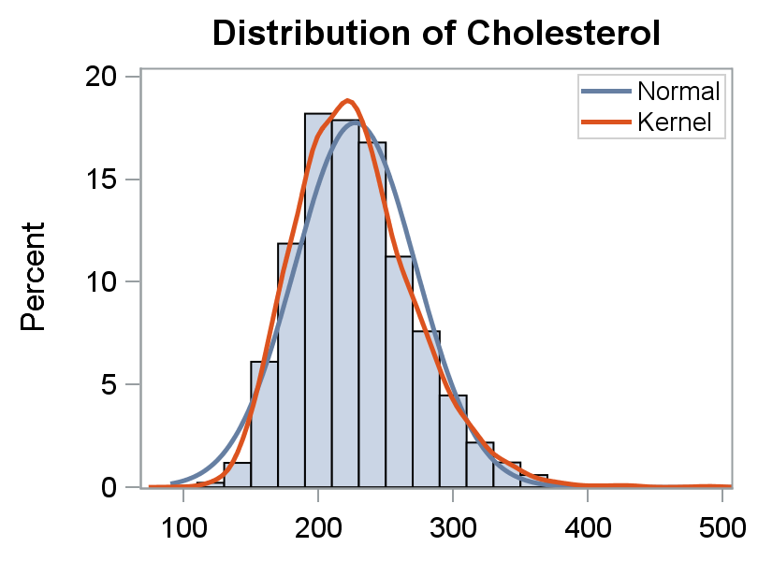
Exercise 1 shell

Slide 21
Exercise 1: example code
proc sgplot data=sashelp.heart;
histogram cholesterol;
density cholesterol;
density cholesterol / type=kernel;
keylegend / location=inside
position=topright
across=1
linelength=20;
xaxis display=(nolabel);
run;

Slide 22
XAXISTABLE / YAXISTABLE
The XAXISTABLE and YAXISTABLE statements support tabular data to be placed alongside the x and y axes. The statements can be used to add the numbers of subjects included in the analysis or at risk of an event.
Rows and columns of data can be displayed inside or outside the axes.
If a variable isn’t specified, SAS uses the “active” variable
Tables can be split using a CLASS variable
The COLORGROUP option assigns colours based on the value of the COLORGROUP variable

Slide 23
Exercise 2. Creating a box plot of QTc
Using the dataset QTcData, create a vertical boxplot showing the distribution of the qtc change from baseline variable (qtc), split by visit and treatment group. Format the graph as follows:
Display the maximum QTc value for each subject at the RHS of the graph (stored in rows where week=28), adding a vertical reference line before the maximum
Ensure the visits are spread linearly with time on the x-axis
An increase of more than 60 is considering high, and an increase of more than 30 is considered concerning. Add horizontal reference lines at 0, 30 and 60 and an appropriate footnote.
Label the axes appropriately (x-axis does not need a label)

Slide 24
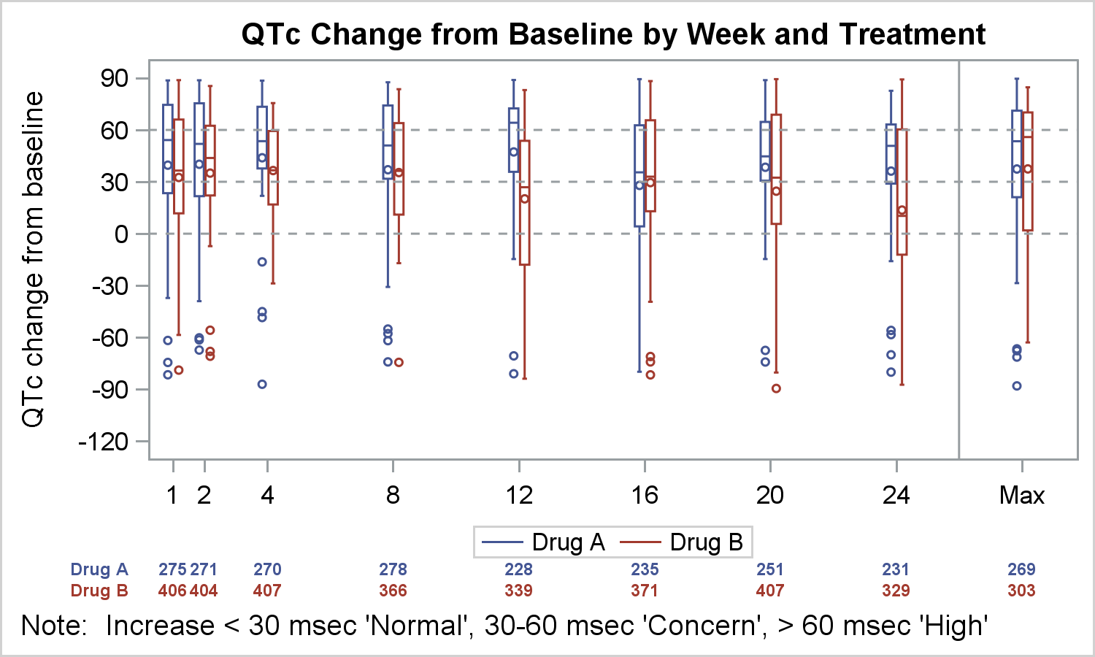
Exercise 2. Creating a box plot of QTc

Slide 25
Exercise 2: example code
title1 “QTc Change from Baseline by Treatment and Week”;
footnote1 j=1 “Note: Increase < 30 msec ‘Normal’ , “30-60 msec ‘Concern’, >60 msec ‘High’ “;
proc sgplot data=QTcData;
format week qtcweek.;
vbox qtc / category=week group=drug groupdisplay=cluster nofill;
refline 26 / axis=x;
refline 0 30 60 / axis=y lineattrs=(pattern=shortdash);
keylegend / title=‘’
linelength=20;
xaxis type=linear values=(1 2 4 8 12 16 20 24 28) max=29
display=(nolabel);
run;

Slide 26
Exercise 2: example code
title1 “QTc Change from Baseline by Treatment and Week”;
footnote1 j=1 “Note: Increase < 30 msec ‘Normal’ , “30-60 msec ‘Concern’, >60 msec ‘High’ “;
proc sgplot data=QTcData;
format week qtcweek.;
vbox qtc / category=week group=drug groupdisplay=cluster nofill;
refline 26 / axis=x;
refline 0 30 60 / axis=y lineattrs=(pattern=shortdash);
keylegend / title=‘’
linelength=20;
xaxis type=linear values=(1 2 4 8 12 16 20 24 28) max=29
display=(nolabel);
run;
This option places the treatment groups side by side in the graph.

Slide 27
Exercise 2: example code
title1 “QTc Change from Baseline by Treatment and Week”;
footnote1 j=1 “Note: Increase < 30 msec ‘Normal’ , “30-60 msec ‘Concern’, >60 msec ‘High’ “;
proc sgplot data=QTcData;
format week qtcweek.;
vbox qtc / category=week group=drug groupdisplay=cluster nofill;
refline 26 / axis=x;
refline 0 30 60 / axis=y lineattrs=(pattern=shortdash);
keylegend / title=‘’
linelength=20;
xaxis type=linear values=(1 2 4 8 12 16 20 24 28) max=29
display=(nolabel);
run;
This ensures the visits are spread out linearly in time rather than being equally spaced

Slide 28
Placement of X/YAXISTABLE data
By adding the following code, we can create a table of the numbers of subjects included in the analyses at the bottom of the graph:
xaxistable risk / class=drug colorgroup=drug;
Adding the option location=inside to this statement is an additional improvement.

Slide 29
Exercise 2. Creating a box plot of QTc
with xaxistable option

Slide 30
Exercise 2: example code
title1 “QTc Change from Baseline by Treatment and Week”;
footnote1 j=1 “Note: Increase < 30 msec ‘Normal’ , “30-60 msec ‘Concern’, >60 msec ‘High’ “;
proc sgplot data=QTcData;
format week qtcweek.;
vbox qtc / category=week group=drug groupdisplay=cluster nofill;
xaxistable risk / class=drug colordrug=drug location=inside;
refline 26 / axis=x;
refline 0 30 60 / axis=y lineattrs=(pattern=shortdash);
keylegend / title=‘’
linelength=20;
xaxis type=linear values=(1 2 4 8 12 16 20 24 28) max=29
display=(nolabel);
run;

Slide 31
Shading regions of the display area
Regions of the graph can be shaded using BAND plot statements:
band x=wk y=L0 / fill legendlabel=‘Normal’
name=‘a’ fillattrs=(color=white
transparency=0.6);
(Use the QTCBAND dataset : L0 is a variable in the dataset)

Slide 32
Adding text to the graph
Text can be added using the TEXT plot statement:
text x=wk y=ylabel text=label;

Slide 33
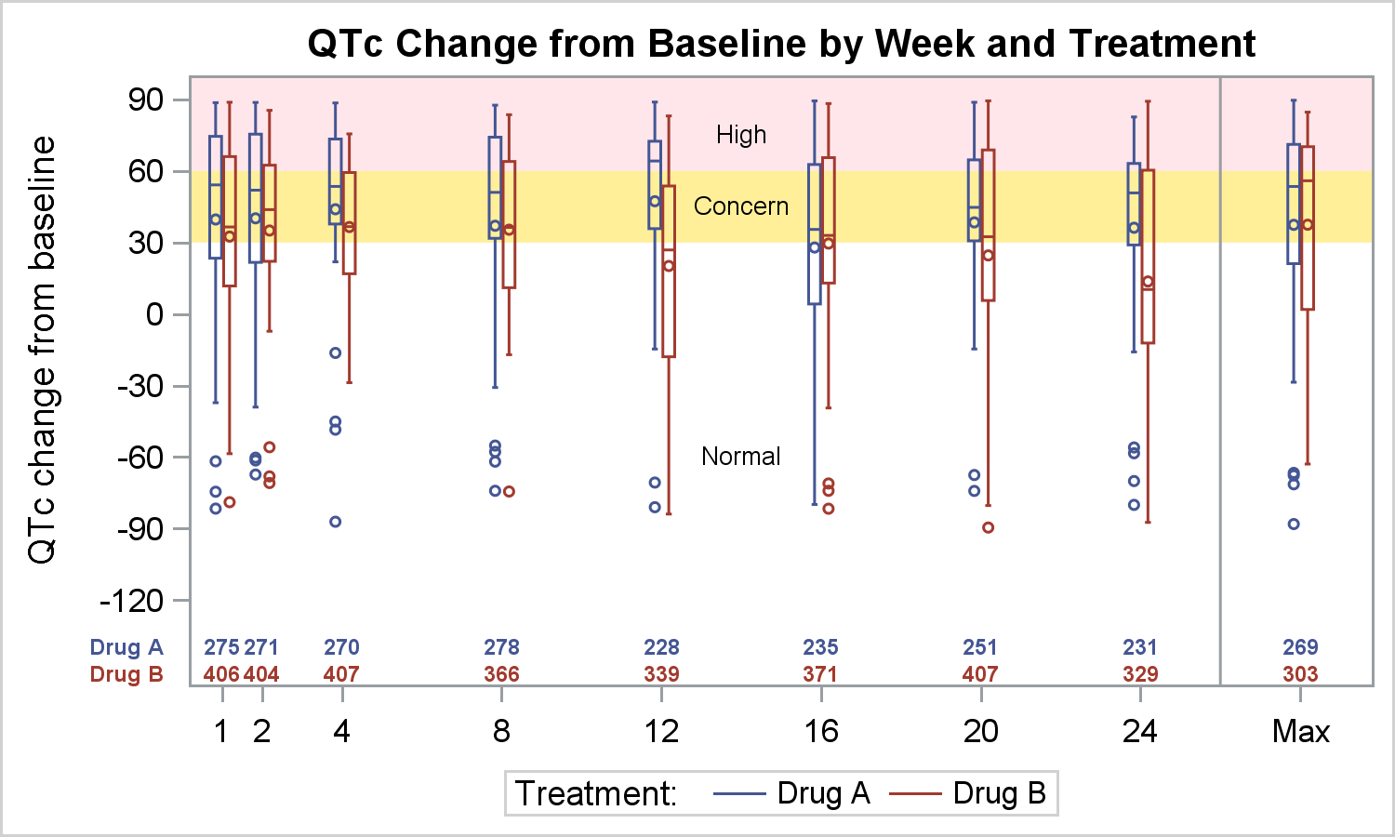
Exercise 2. Creating a box plot of QTc
with xaxistable option (location=inside) and shading and text added

Slide 34
Exercise 3. Creating a line plot of mean QTc
Using the dataset QTc_Mean_Group, create a plot showing the mean values of qtc change from baseline variable (qtc), split by visit and treatment group. Format the graph as follows:
Display the last QTc value (LOCF) for each subject at the RHS of the graph (stored in rows where week=28), adding a vertical reference line before the maximum.
A line should join all weeks within a treatment group EXCEPT the LOCF week (hint: check “mean” vs “mean2” variables)
A symbol should represent treatment group at each visit (with an appropriate legend)
Error bars should be present (use variables “high” and “low”)
Ensure the visits are spread linearly with time on the x-axis
Add a horizontal reference line at 0
Label the axes appropriately (x-axis does not need a label)
Include the number of subjects included in the analysis (inside the x axis)

Slide 35
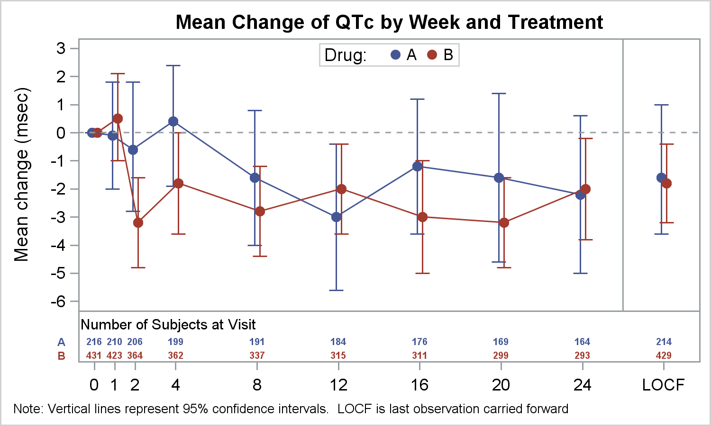
Exercise 3. Creating a line plot of mean QTc

Slide 36
Exercise 3: example code
title1 “Mean QTc Change by Treatment and Week”;
proc sgplot data=QTc_Mean_Group;
format week qtcweek.;
scatter x=week y=mean / yerrorupper=high yerrorlower=low
group=drug groupdisplay=cluster clusterwidth=0.5
markerattrs=(size=7 symbol=circlefilled) name=‘a’;
series x=week y=mean2 / group=drug groupdisplay=cluster clusterwidth=0.5;
xaxistable n / class=drug colorgroup=drug location=inside
valueattrs=(size=5 weight=bold)
labelattrs=(size=6 weight=bold) separator
title=“Number of Subjects at Visit” titleattrs=(size=8);
refline 26 / axis=x;
refline 0 / axis=y lineattrs=(pattern=shortdash);
keylegend ‘a’ / title=‘Drug: ’ location=inside position=top;
xaxis type=linear values=(1 2 4 8 12 16 20 24 28) max=29
valueshint display=(nolabel);
yaxis label=“Mean change (msec)” values=-6 to 3 by 1;
run;

Slide 37
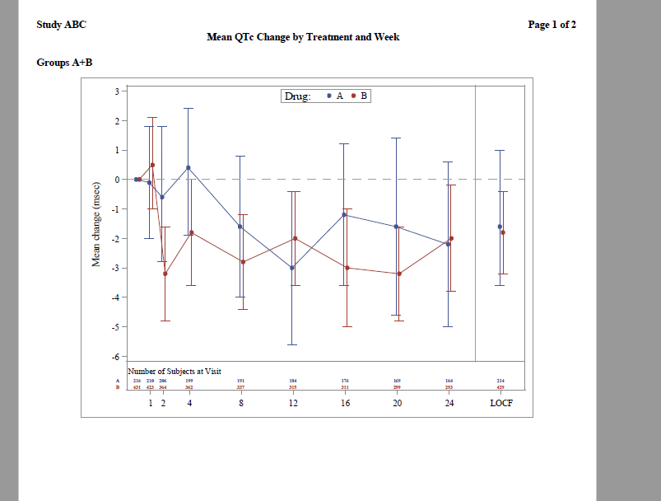

Slide 38
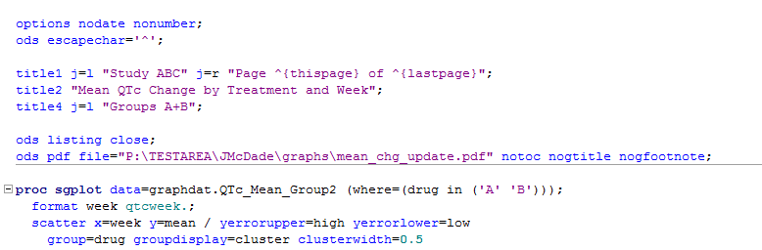

Slide 39
Exercise 4. Survival Plot
Note: it’s possible to create survival plots using PROC LIFETEST with PLOTS = survival option. PROC SGPLOT should only be used where the PROC LIFETEST graph needs to be customised more than is allowable in PROC LIFETEST.
Using the dataset “SurvivalPlotData”, create a step plot of the survival times by strata, overlaying censored patients using symbols. Display the number of patients at risk inside the x-axis (hint: use STEP statement).

Slide 40
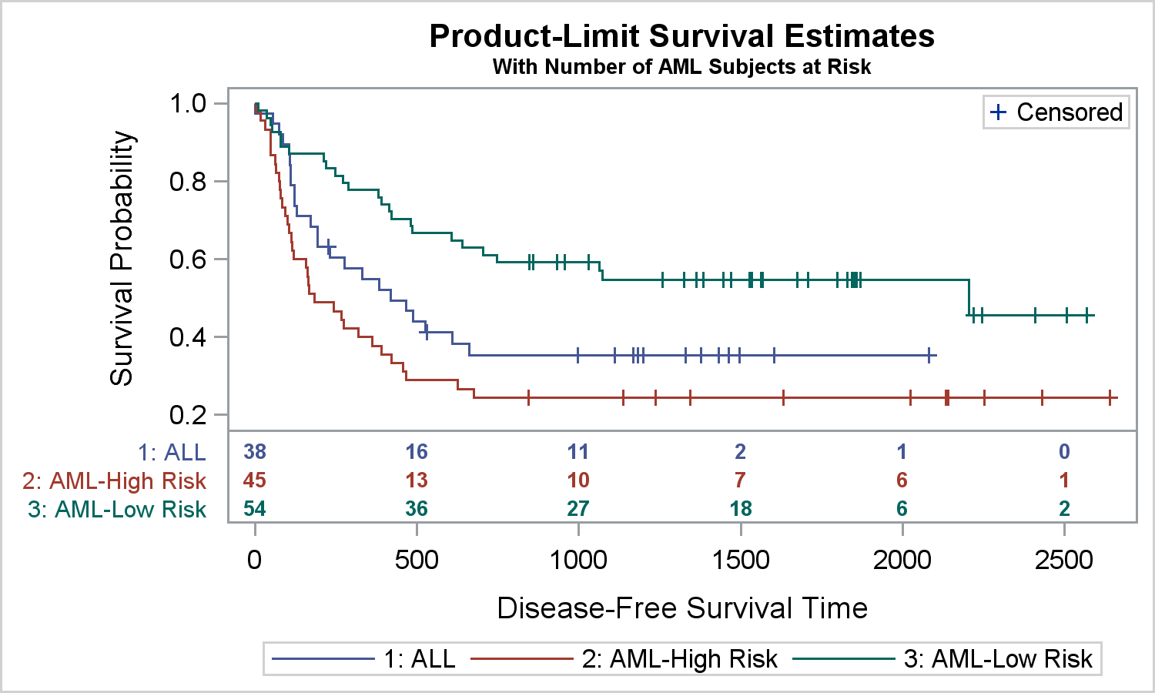
Exercise 4. Survival Plot

Slide 41
Exercise 4: example code
title1 “Proportion of Subjects Surviving”;
proc sgplot data=SurvivalPlotData;
step x=time y=survival / group=stratum lineattrs=(pattern=solid)
name=“s”;
scatter x=time y=censored / markerattrs=(symbol=plus) name=‘c’;
scatter x=time y=censored / markerattrs=(symbol=plus) group=stratum;
xaxistable atrisk / x=tatrisk class=stratum colorgroup=stratum
location=outside;
keylegend ‘c’ / location=inside position=topright;
keylegend ‘s’ ;
run;

Slide 42
Exercise 5. Forest Plot
Using the dataset “Forest”, create a forest plot showing all of the individual study results as well as an overall pooled result. Display the individual study and pooled results to the right of the forest plot.
Each study results comprises an odds ratio with a 95% confidence interval. An odds ratio of 1 means the drug works the same as placebo, less than 1 indicates that the drug is working as hoped.

Slide 43
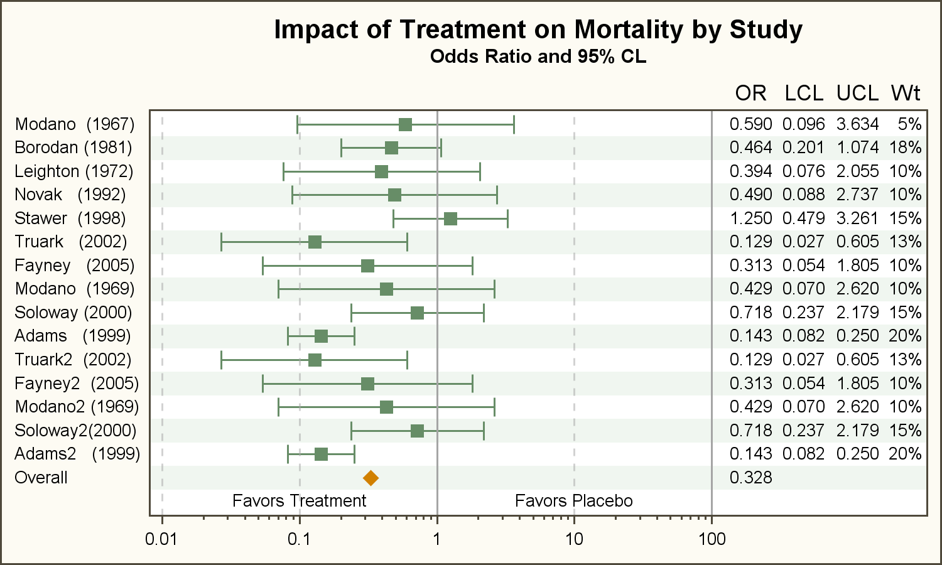
Exercise 5. Forest Plot

Slide 44
Exercise 5: example code
title1 “Impact of Treatment by Mortality by Study”;
proc sgplot data=forest noautolegend nocycleattrs;
styleattrs datasymbols=(squarefilled diamondfilled);
scatter y=study x=or / xerrorupper=ucl xerrorlower=lcl group=grp;
yaxistable or lcl ucl wt / y=study location=inside position=right;
refline 1 100/ axis=x noclip;
refline 0.01 0.1 10 / axis=x lineattrs=(pattern=shortdash) noclip;
text y=study x=xlbl text=lbl / position=center;
xaxis type=log max=100 minor display=(nolabel) valueattrs=(size=7);
yaxis display=(noticks nolabel) fitpolicy=none reverse
valueshalign=left colorbands=even valueattrs=(size=7);
run;

Slide 45
Exercise 6. Waterfall Plot
Using the dataset “TumorSize”, create a waterfall plot showing bars for individual patient changes in tumour size. Order the bars by the change in tumour size. Patients from different treatment groups should have their bar shaded in a different colour. Place a letter at the top of each bar indicating tumour response category.

Slide 46
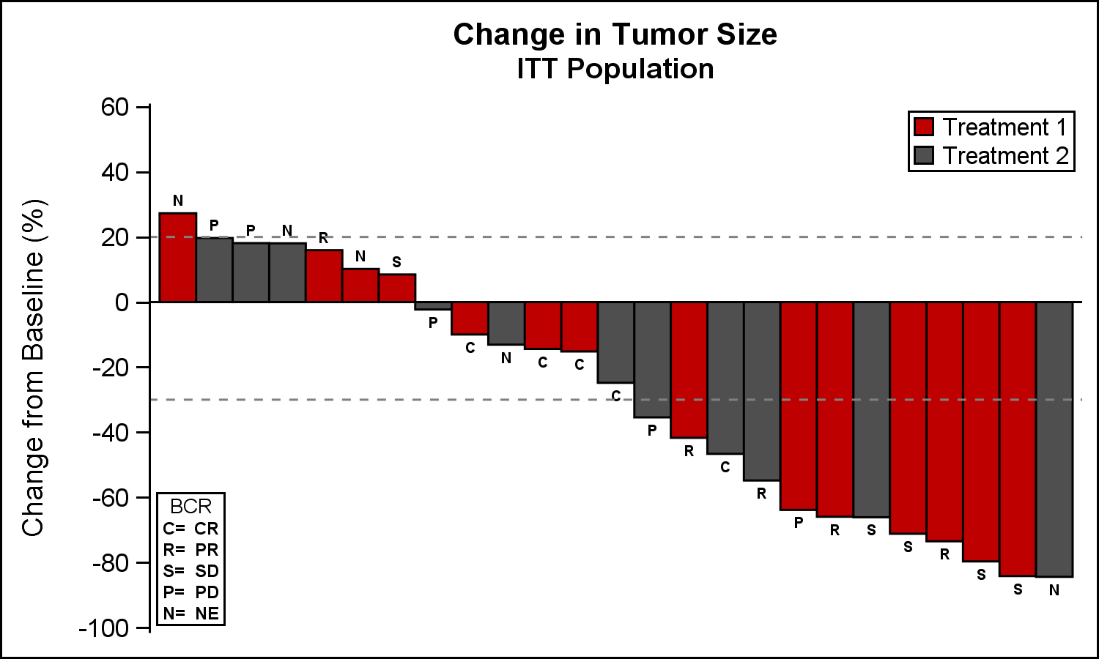
Exercise 6. Waterfall Plot

Slide 47
Exercise 6: example code
title1 “Change in Tumour Size”;
title2 “ITT Population”;
proc sgplot data=tumorsize nowall noborder;
styleattrs datacolors=(cxbf0000 cx4f4f4f) datacontrastcolors=(black);
vbar cid / response=change group=group categoryorder=respdesc
datalabel=label datalabelattrs=(size=5) groupdisplay=cluster
clusterwidth=1;
refline 20 -30 / lineattrs=(pattern=shortdash);
xaxis display=none;
yaxis values=60 to -100 by -20;
inset (“C=”=“CR” “R=”=“PR” “S=”=“SD” “P=“=“PD” “N=“=“NE”) / title=‘BCR’
position=bottomleft border textattrs=(size=6) titleattrs=(size=7);
keylegend / title=‘’ location=inside position=topright across=1 border;
run;

Slide 48
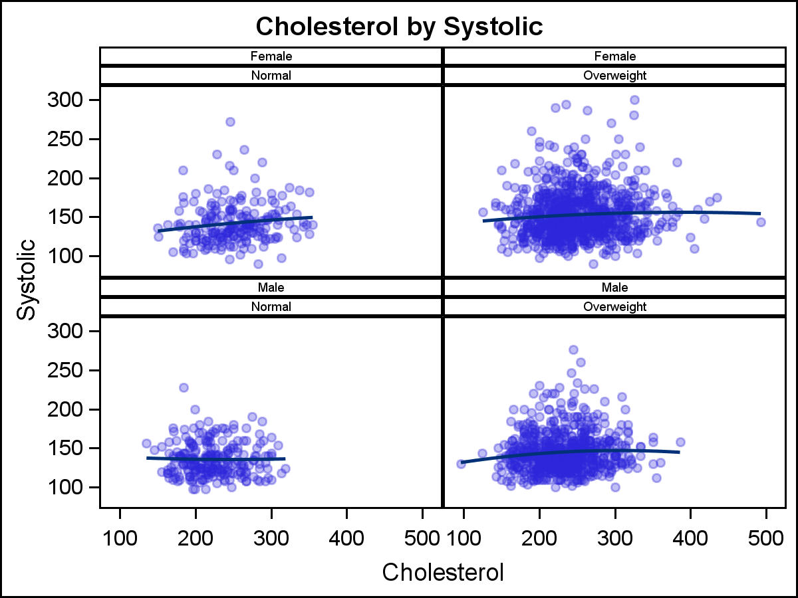
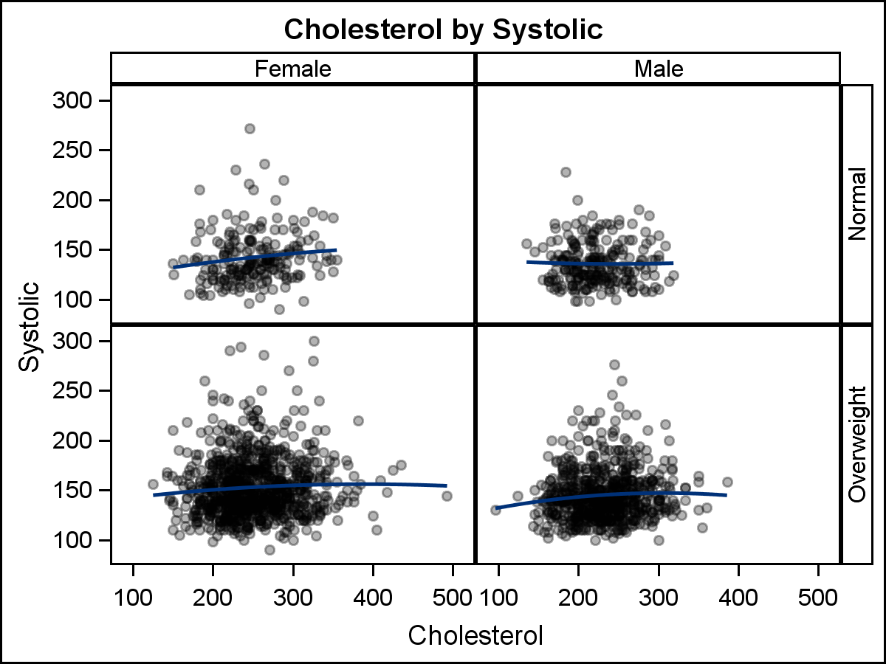
PROC SGPANEL
PROC SGPANEL produces multi-cell graphs. Plots are split by one or more class variables.

Slide 49
SGPANEL Syntax
proc sgpanel data=<dataset> <options>;
panelby classvar1 <classvar2 classvar3…> / <options>;
plot statement(s) required parameters </options>;
<styleattrs statements>;
<refline statements>;
<axis statements>;
<inset statements>;
<keylegend statements>;
run;

Slide 50
SGPANEL Syntax
proc sgpanel data=<dataset> <options>;
panelby classvar1 <classvar2 classvar3…> / <options>;
plot statement(s) required parameters </options>;
<styleattrs statements>;
<refline statements>;
<axis statements>;
<inset statements>;
<keylegend statements>;
run;
The PANELBY statement is required and must be before any of the plot, refline, inset, axis or legend statements. The statement is used to set the layout type. The following options are supported:
PANEL (default)
LATTICE – creates a panel with rows and columns
COLUMNLATTICE – creates a one row panel with columns
ROWLATTICE – creates a one column panel with rows

Slide 51
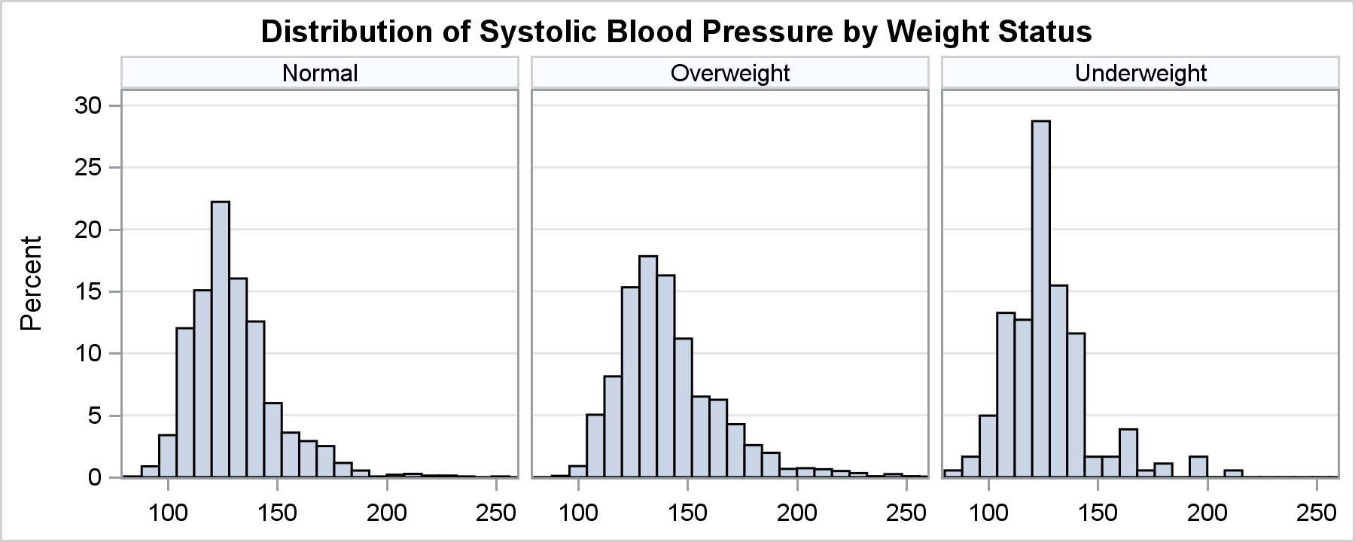
Exercise 7: Simple panel graph
Using the dataset SASHELP.HEART, created a panel of histograms of systolic blood pressure, split by the variable “weight_status”.

Slide 52
Exercise 7: Example code
title “Distribution of Systolic Blood Pressure by Weight Status”;
proc sgpanel data=sashelp.heart;
panelby weight_status ;
histogram systolic;
run;

Slide 53
Exercise 8: Panel of LFT Shifts with Concern Levels
Using the dataset lftshiftnorm, created a panel of histograms of baseline versus maximum on-treatment value for the following test codes: ALAT, ALKPH, ASAT, BILTOT. Format according to the following:
create all plots in 1 row
add horizontal and vertical reference lines at 1, 1.5 and 2 times the upper limit of normal
Ensure the counts of patients in the population are in the legend, along with treatment descriptors
All graphs should use the same axis range

Slide 54
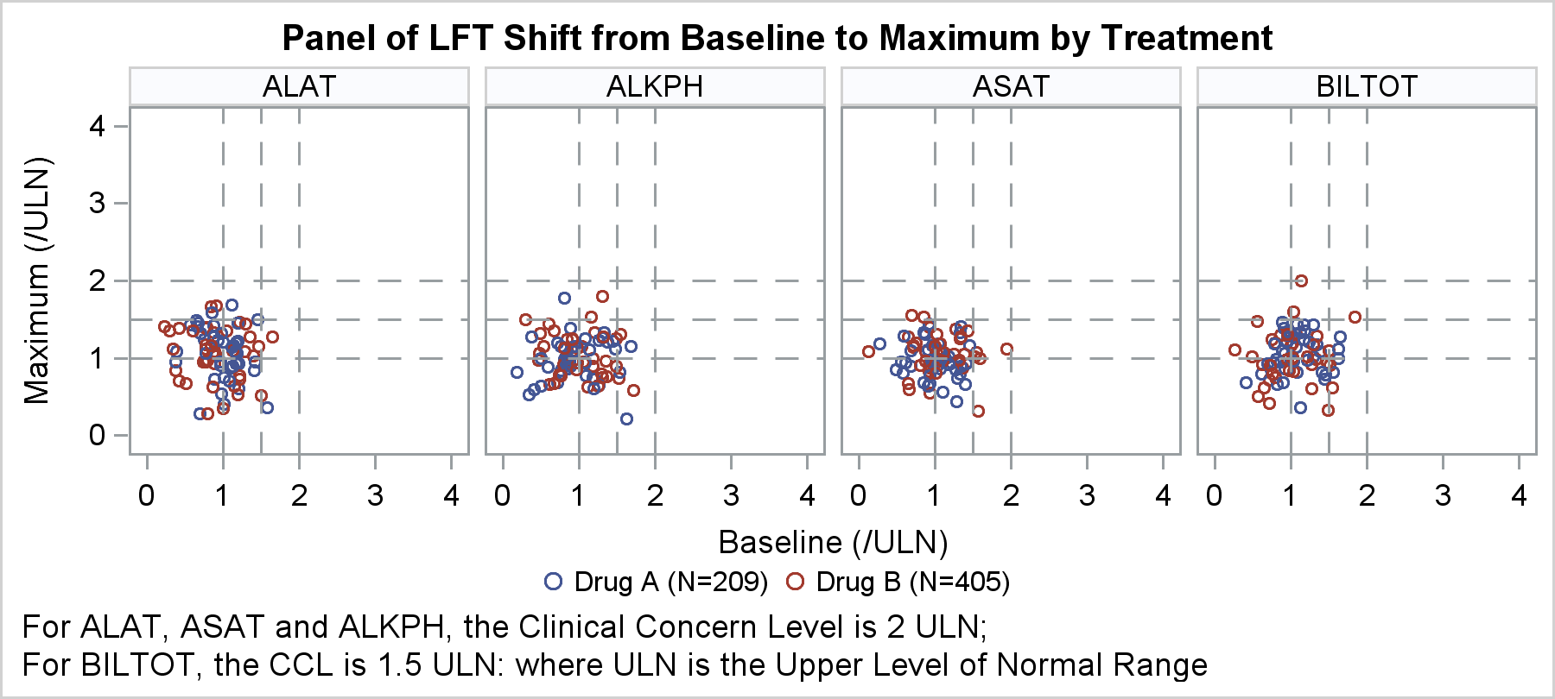
Exercise 8: Panel of LFT Shifts with Concern Levels

Slide 55
Exercise 8: example code
proc sgpanel data=lftshiftnorm;
panelby test / layout=panel columns=4 spacing=10 novarname;
scatter x=base y=max / group=drug;
refline 1 1.5 2 / axis=y lineattrs=(pattern=dash);
refline 1 1.5 2 / axis=x lineattrs=(pattern=dash);
rowaxis integer min=0 max=4;
colaxis integer min=0 max=4;
keylegend / title=“” noborder ;
run;

Slide 56
ODS Graphics options
Using ODS GRAPHICS statement many aspects of the graphics files can be controlled. This includes the image format, name, height and width.
This is equivalent to GOPTIONS in traditional SAS/GRAPH
ODS LISTING destination supports maximum number of image formats (default PNG)
Default size 640 x 480 pixels. Specify only one dimension, SAS will maintain default aspect ratio 4:3.
Specify height and width in these units: CM, IN, MM, FT, PX

Slide 57
ODS Graphics options (example)
Option Description Example
OUTPUTFMT= specifies image format OUTPUTFMT = JPEG
IMAGENAME= specifies base filename for image IMAGENAME = 'MyGraph'
HEIGHT= specifies height HEIGHT = 4IN
WIDTH= specifies width WIDTH = 8CM
RESET resets any preceding options to RESET
default values

Slide 58
ODS destination and styles
Some commonly used destination
Listing (default up to SAS 9.2)
HTML (default in SAS 9.3)
RTF
PDF

Slide 59
ODS destination and styles (RTF)
Widely used in clinical data reporting
Creates Rich Text Format (RTF) files. Compatible with MS Word. Graphics images will be embedded in the file.
Graphics options to ODS RTF
FILE = “filename”
IMAGE_DPI = number. Specifies image resolution, default 100
STYLE = style name. Default RTF.
Support PNG, EMF and JPEG images. Does not support GIF.

Slide 60
Exercise 9: ODS Graphics and Styles
Create a RTF file on your desktop using the plot generated in exercise 1.
Use grayscale visual display.
Use output format PNG
Height 8 inch, width 9 inch
No external border for the image

Slide 61
Exercise 9: ODS Graphics and Styles
ODS GRAPHICS / HEIGHT=8in
WIDTH=9in
NOBORDER
OUTPUTFMT=png
IMAGENAME=“test”;
ODS RTF FILE=“test.rtf”
IMAGE_DPI=300
STYLE=JOURNAL;
ODS RTF CLOSE;

Slide 62
Further reading
SAS help : http://support.sas.com/documentation/94/
Statistical Graphics Using ODS (SAS 9.2)
Book: “Clinical Graphs Using SAS” by Sanjay Matange
Matange, Sanjay. "Graphically Speaking." Available at http://blogs.sas.com/content/graphicallyspeaking/
More examples from John McDade: click here

Slide 63
THANK YOU

